Slide 1
PCB DESIGNING Project : IOT BASED SMART PARKING USING BEAGLEBONE BLACK WIRELESS
Submitted by: Sruthy Krishnan
(C0749122) Group #1

Slide 2
CONTENTS
Introduction
EasyEDA
Creating new project
Design Steps
PCB layout from EasyEDA
Gerber view of top layer
Gerber view of bottom layer
Complete Gerber view
References

Slide 3
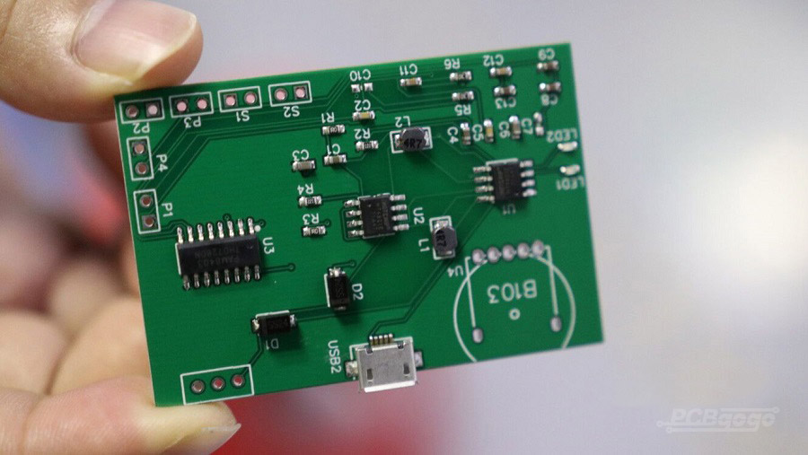
introduction
Steps for PCB designing
1. Design the circuit on a PCB design software
2. Transfer the layout to a board
3. The etching process
4. Populate the board and test the circuit
As PCB fabrication is a costly task, we are doing only the software part

Slide 4
Easyeda
EasyEDA is used for PCB designing
More than 1 million free libraries are available
It provide work anywhere, anytime feature with its online version.
It provide direct link to electronics components for selection.
Gerber files of the PCB design can be created and downloaded
This can be viewed with the help of a third party Gerber viewer.
Printable PCB layer image output is also supported in PDF, PNG and SVG formats
It provide integrated PCB Fabrication

Slide 5





Creating new project
Download EasyEDA software.
Create new project.
Add PCB Design page.
Search and add components from library.
Draw connection between the terminals.

Slide 6
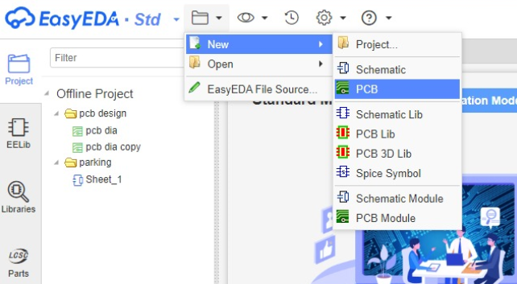
Design steps
Click on File → New → PCB for opening a new project

Slide 7
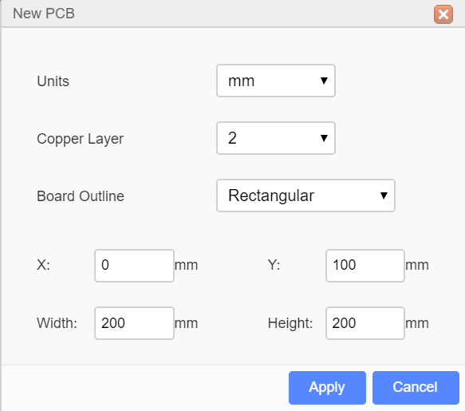
Contd…
When we open the PCB design page, a dialog box will pop up
Select the number of copper layers required and shape of the board outline
Also set the width and height of the board outline

Slide 8
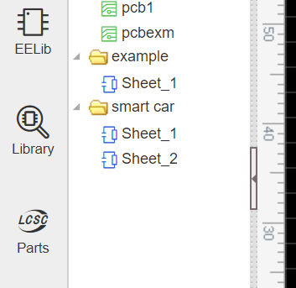
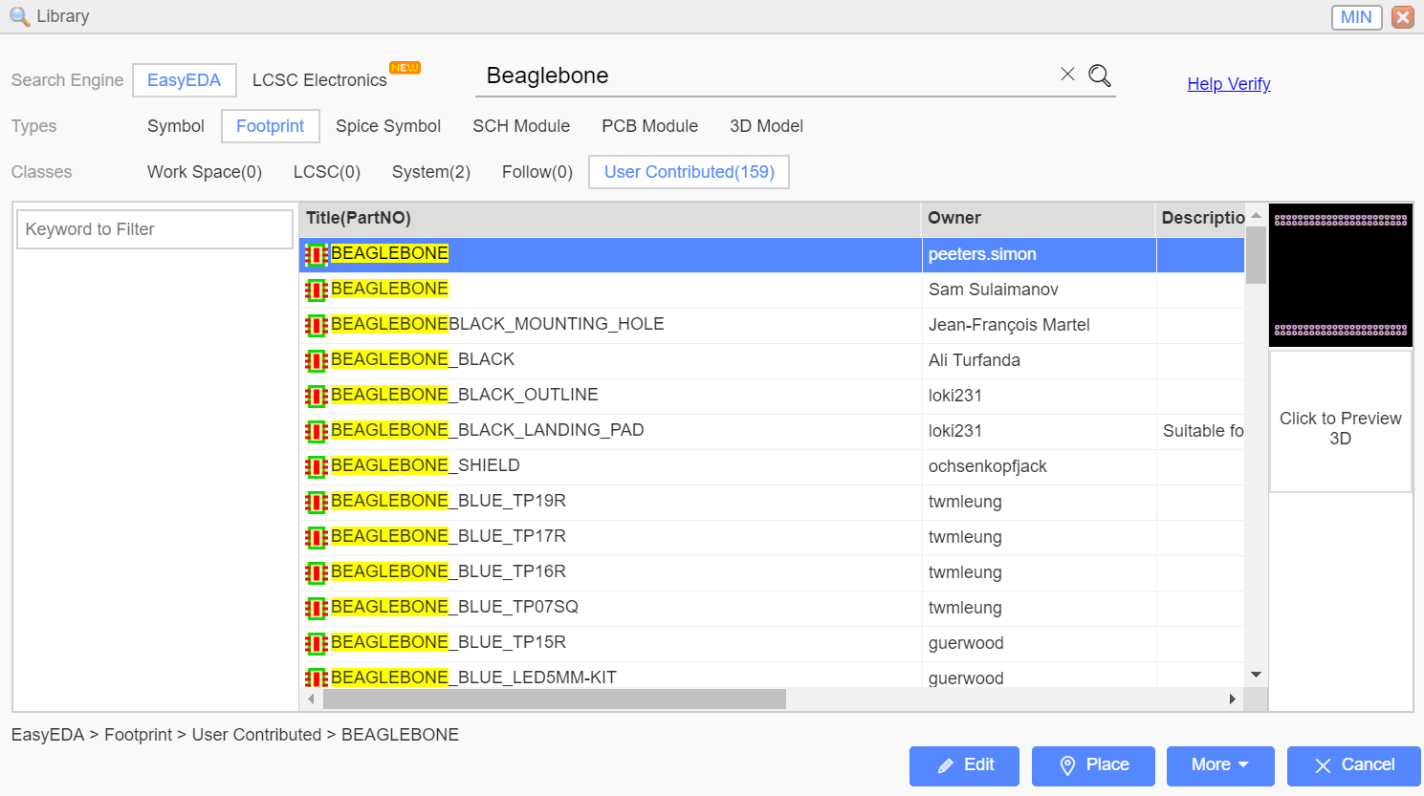
Select the required components from the “Library” tab
Select the desired component by setting the types to “footprint” from the available options and click on
“Place” the component.

Slide 9
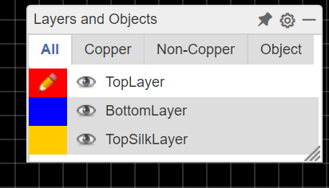
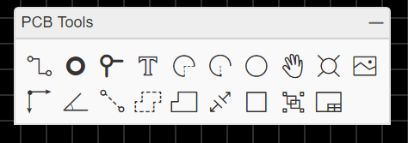
After placing all the components, connections can be made on top layer or bottom layer by selecting it from layers and objects
Use ‘PCB tool’ tab on the top for options to connect the components.

Slide 10
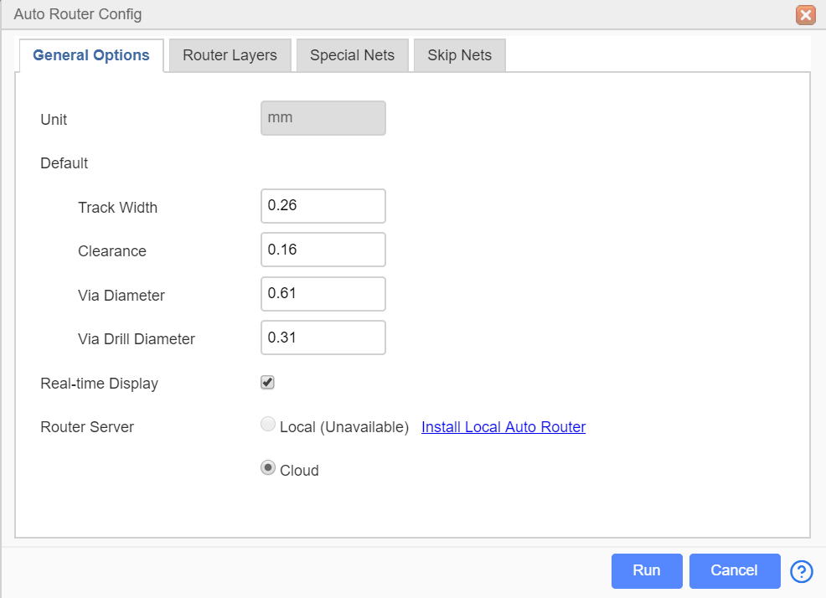
In order to get the correct clearance between each trace, auto routing can be done after connecting each component.
It provide effective routing of traces by minimizing vias.
It can be done by clicking Route → Auto Router

Slide 11
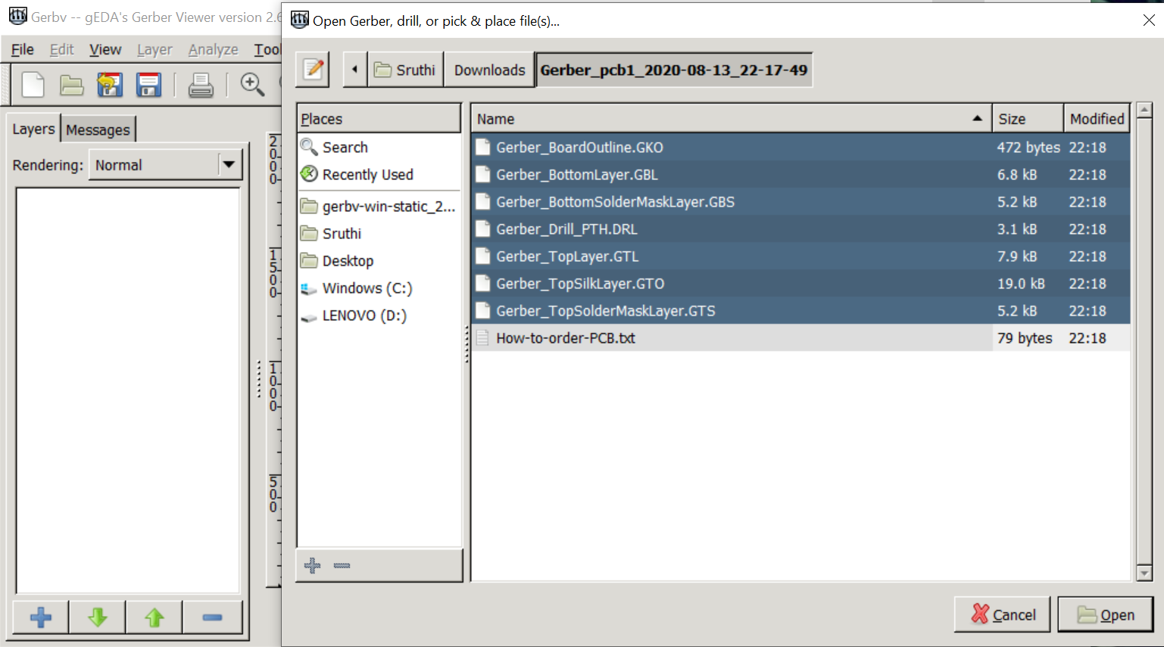
After connecting all the components, generate the Gerber file by clicking on File → Generate PCB Fabrication file
Gerber file can be downloaded and viewed with the help of a third party Gerber viewer – Gerbv
Unzip the downloaded gerber file and run Gerbv
Click the + button at the Gerbv dialog bottom-left corner, open the gerber folder, select all the gerber files and open.

Slide 12
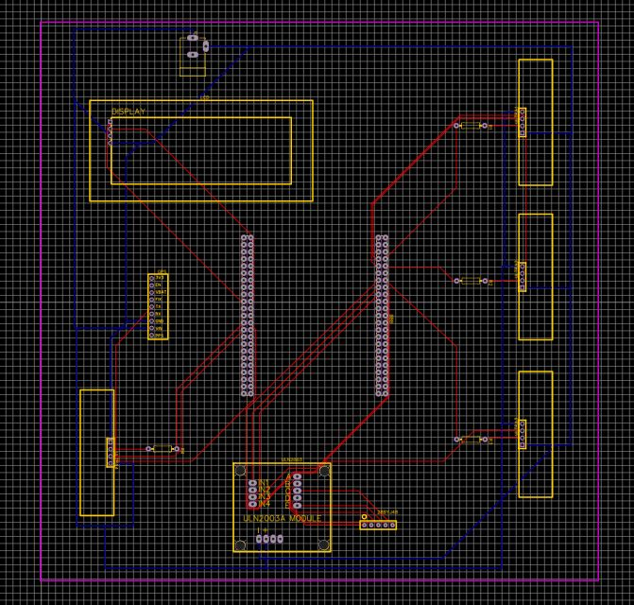
PCB Layout from easyeda

Slide 13
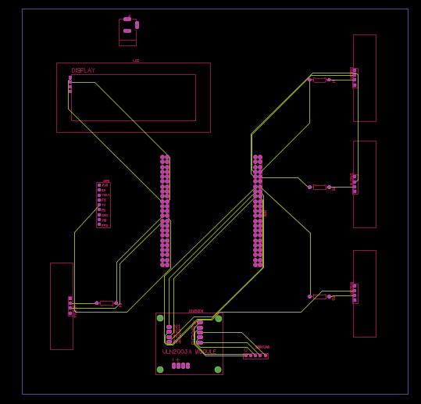
Gerber view of top layer

Slide 14
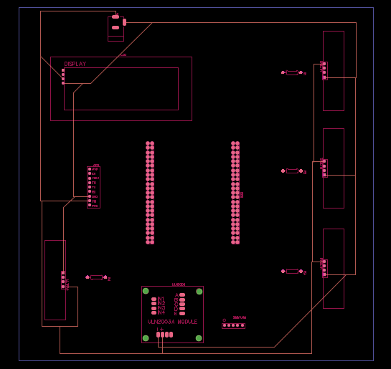
Gerber view of bottom layer

Slide 15
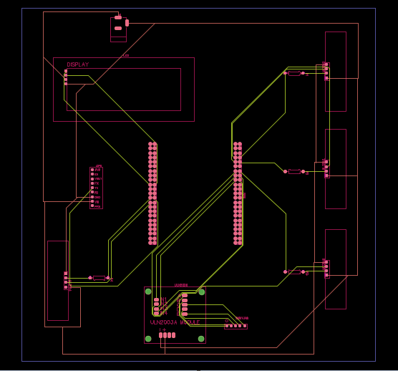
Complete gerber view

Slide 16
References
EasyEDA (ND). EasyEDA retrieved from: https://easyeda.com/page/about
Instructable circuits(ND). PCB Designing using EasyEDA retrieved from: https://www.instructables.com/id/PCB-Designing-Using-EasyEDA/
Sourceforge(ND). Gerbv – a Gerber (RS-274X) viewer retrieved from: https://sourceforge.net/projects/gerbv/

